Slide 1
Implementing Dynamic Foot Shape Models to Improve Spacesuit Boot Fit
Abhishektha (Abhi) Boppana | PhD Comprehensive Exam
Nov 18 2020

Slide 2
Thesis Committee
Allison Anderson, PhD - CU Boulder Aerospace Engineering Sciences
David Klaus, PhD - CU Boulder Aerospace Engineering Sciences
Torin Clark, PhD - CU Boulder Aerospace Engineering Sciences
Rodger Kram, PhD - CU Boulder Integrative Physiology
Daniel Feeney, PhD - BOA Technology

Slide 3
Motivation
Planetary exploration and spacesuit injury incidence

Slide 4
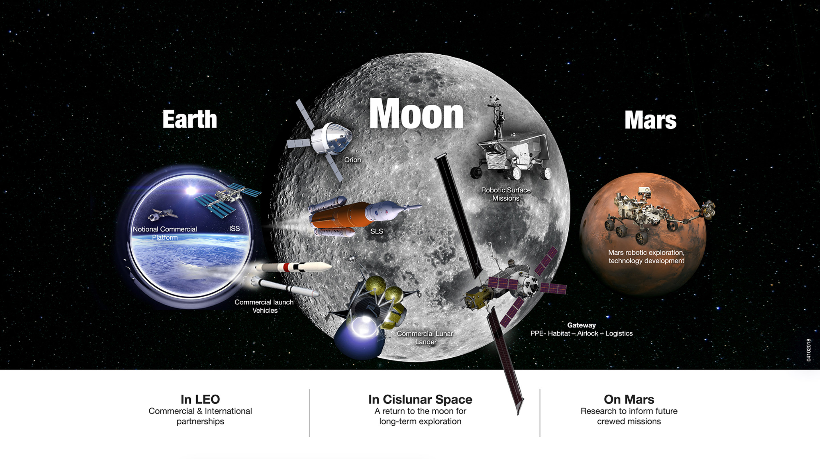
Notes:
The future of crewed space exploration is planetary.

Slide 5
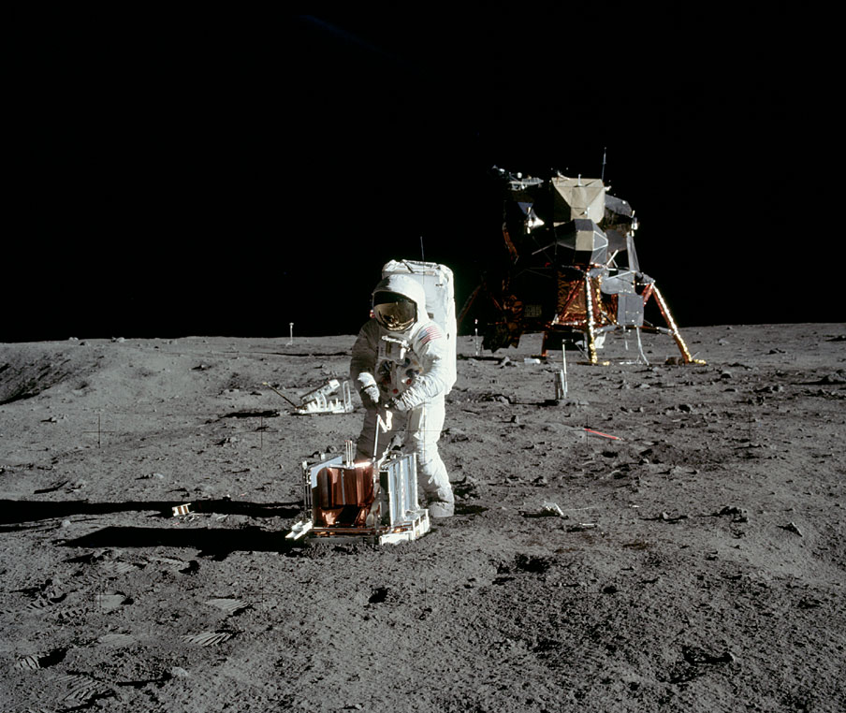
Planetary Exploration
“Success of planetary exploration depends on the ability of humans to work on and explore the surface”¹
Experience limited to 78 hours over 15 Apollo missions²
1.8 km longest traverse (Apollo 12)
22 hrs EVA/36 hour stay (Apollo 17)
Buzz Aldrin performing EVA tasks on Apollo 11 (nasa.gov)
¹Drake BG, Watts KD. Human Exploration of Mars Design Reference Architecture 5.0 (2014). NASA/SP-2009-566-ADD2.
²Portree, D. S., and Trevino, R. C., Walking to Olympus: An EVA Chronology, NASA History Office, Washington, DC, 1997.

Slide 6
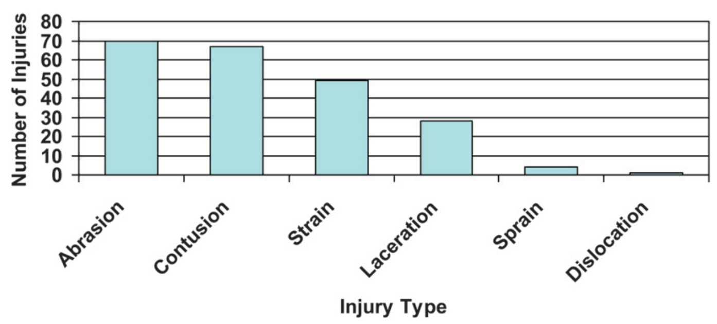
EVA Injury Incidence
EVA suit components are the leading source of in-flight injuries²
Apollo astronauts complained about fatigue from reduced mobility¹
EMU injuries occurring both in-flight and during ground-based training sessions
Contact Injuries
Musculoskeletal Injuries
In-flight injuries throughout the U.S. space program. Modified from Scheuring et al. 2009²
¹Scheuring, R. A., Jones, J. A., Novak, J. D., Polk, J. D., Gillis, D. B., Schmid, J., Duncan, J. M., and Davis, J. R., “The Apollo Medical Operations Project: Recommendations to Improve Crew Health and Performance for Future Exploration Missions and Lunar Surface Operations,” Acta Astronautica, Vol. 63, Nos. 7–10, 2008, pp. 980–987.
²Scheuring, R. A., Mathers, C. H., Jones, J. A., and Wear, M. L., “Musculoskeletal Injuries and Minor Trauma in Space: Incidence and Injury Mechanisms in U.S. Astronauts,” Aviation Space and Environmental Medicine, Vol. 80, No. 2, 2009, pp. 117–124.

Slide 7
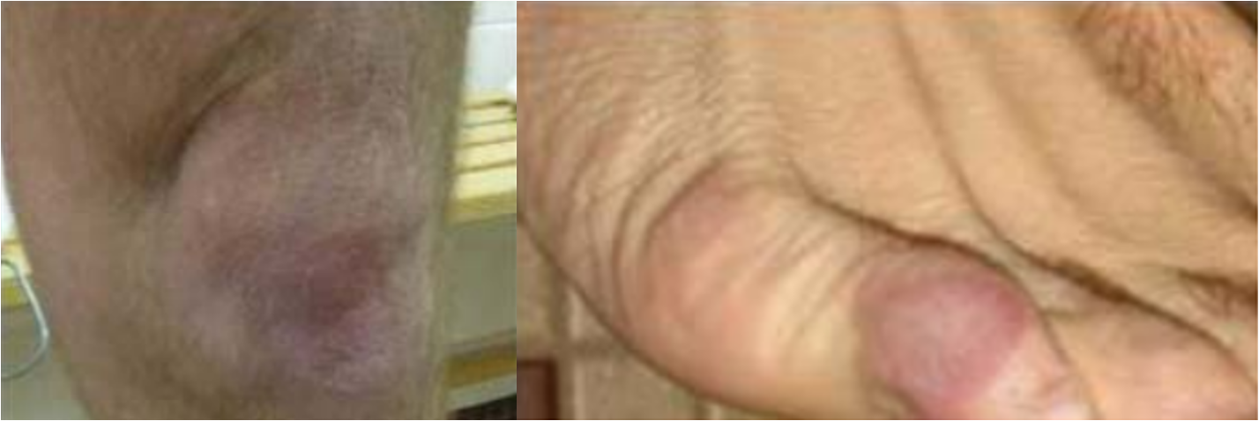
EVA Injury Incidence
EVA suit components are the leading source of in-flight injuries²
Apollo astronauts complained about fatigue from reduced mobility¹
EMU injuries occurring both in-flight and during ground-based training sessions
Examples of spacesuit injury occurring during training
¹Scheuring, R. A., Jones, J. A., Novak, J. D., Polk, J. D., Gillis, D. B., Schmid, J., Duncan, J. M., and Davis, J. R., “The Apollo Medical Operations Project: Recommendations to Improve Crew Health and Performance for Future Exploration Missions and Lunar Surface Operations,” Acta Astronautica, Vol. 63, Nos. 7–10, 2008, pp. 980–987.
²Scheuring, R. A., Mathers, C. H., Jones, J. A., and Wear, M. L., “Musculoskeletal Injuries and Minor Trauma in Space: Incidence and Injury Mechanisms in U.S. Astronauts,” Aviation Space and Environmental Medicine, Vol. 80, No. 2, 2009, pp. 117–124.

Slide 8
Hypothesized Injury Mechanisms
Poor fit between operator and spacesuit
Gaps leading to excessive contact
Limit mobility when undersized
Poor indexing
Misaligned joint centers can lead to excessive contact during motion
Increased exertion to apply force
Increased Exertion
Difficulty in bending pressurized suit
Poor fit and indexing can lead to increased exertion

Slide 9
Background
Limits in spacesuit mobility and fit

Slide 10
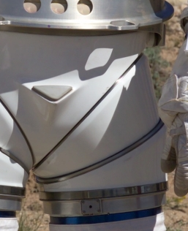
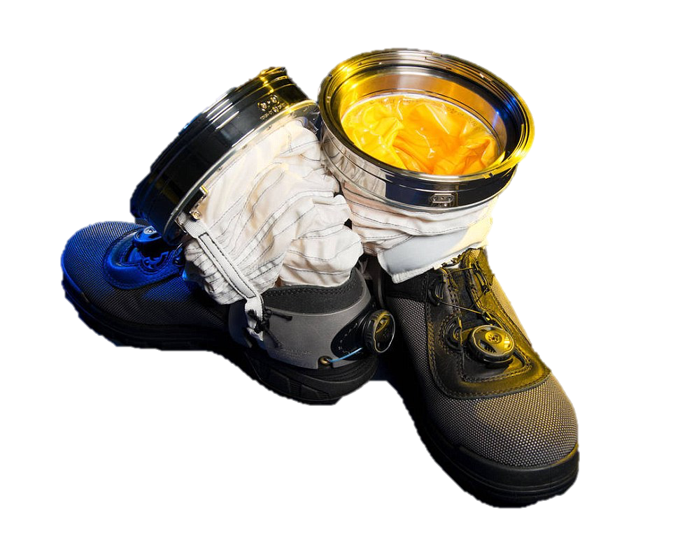
A Stiff, Pressurized Structure
Bending pressurized cylinder reduces volume at joint, hence requiring force¹
Constant volume joints reduce force needed
Examples include²:
Convolutes
Bellows
Hard Joints
Left: Hard joint on MK III spacesuit
Right: Convoluted ankle joint on spacesuit boot
¹Newman, D., and Barratt, M., “Life Support and Performance Issues for Extravehicular Activity (EVA),” Fundamentals of Space Life Sciences, edited by S. Churchill, Krieger Publishing Co., Malabar, FL, 1997, pp. 1–61.
²Harris, G. L., The Origins and Technology of the Advanced Extravehicular Space Suit, American Astronautical Society, San Diego, CA, 2001.

Slide 11
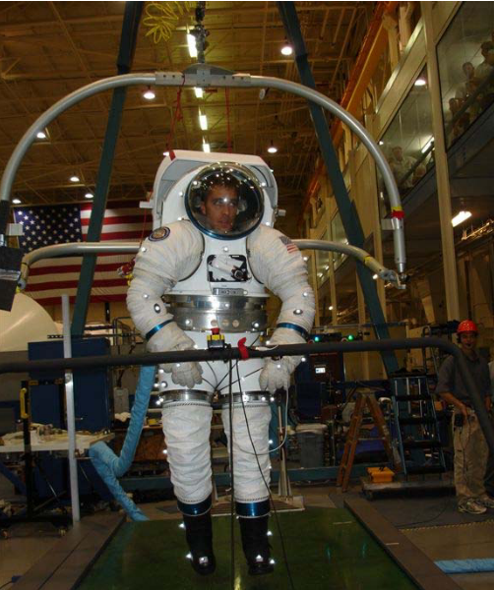
Suited Effects on Ambulation
Suit increases metabolic cost during ambulation¹
Suit pressure and suit weight do not fully explain the increased metabolic cost²
Potential factors: fit, biomechanics of suit, stability
Inhibited mobility while walking compared to unsuited³
Reduced toe and heel clearance
Decreased speed, stride length, step length
Suited ambulation test in the MK III spacesuit²
¹Norcross, J. R., Lee, L. R., Clowers, K. G., Morency, R. M., Desantis, L., DeWitt, J. K., Jones, J. A., Voss, J. R., and Gernhardt, M. L., “Feasibility of Performing a Suited 10-Km Ambulation on the Moon - Final Report of the EVA Walkback Test (EWT),” NASA/TP-2009-214796, NASA Johnson Space Center, Houston, TX, 2009.
²Norcross, J., Clowers, K., Clark, T., Harvill, L., Morency, R. M., Stroud, L. C., Vos, J. R., and Gernhardt, M. L., “Metabolic Costs and Biomechanics of Level Ambulation in a Planetary Suit,” NASA/TP-2010-216115, NASA Johnson Space Center, Houston, TX, 2010.
³Cullinane, C. R., Rhodes, R. A., and Stirling, L. A., “Mobility and Agility during Locomotion in the Mark III Space Suit,” Aerospace Medicine and Human Performance, Vol. 88, No. 6, 2017, pp. 589–596

Slide 12
Spacesuit Fit Limitations
Apollo EVA suits custom tailored¹
Current suits must be fit with variously sized components¹
Sizing rings and tension straps to adjust length
Pads to fill in empty space
Goal: design for 5th percentile female-95th percentile male²
EMU actual accommodation: 40th-95th percentile
What measurement to use for percentiles?
Baseline suit fit derived from operator’s linear anthropometry using proprietary suiting algorithms, then operator feedback used to optimize suit fit²
¹Harris, G. L., The Origins and Technology of the Advanced Extravehicular Space Suit, American Astronautical Society, San Diego, CA, 2001.
²Kim, K. H., Young, K., Benson, E., Jarvis, S., Vu, L., Hernandez, Y., and Rajulu, S., “Human Modeling Tools for Spacesuit and Hardware Design and Assessment,” DHM and Posturography, edited by S. Scataglini and P. Gunther, Academic Press, 2019, pp. 613–625.

Slide 13
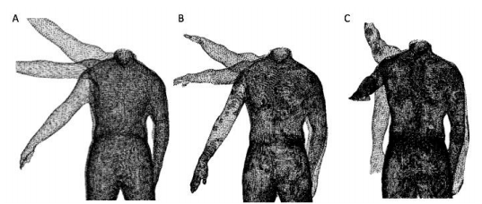
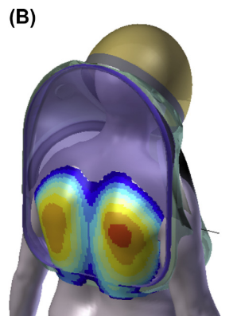
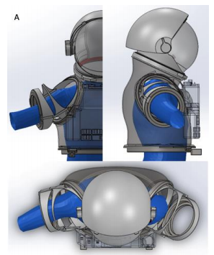
Body-Shape Models for Spacesuits
Linear measurements don’t always represent body shape
Manikins overlaid on 3D suit models to check interference¹
Dynamic models to capture shape changes through motion^{1,2}
Current efforts only capture low-frequency motions
Limited integration into suit design and fit
Dynamic capture of shoulder shape² (top) and testing with hard upper torso^{1,2}
¹Kim, K. H., Young, K., Benson, E., Jarvis, S., Vu, L., Hernandez, Y., & Rajulu, S. (2019). Human modeling tools for spacesuit and hardware design and assessment. In S. Scataglini & P. Gunther (Eds.), DHM and Posturography (pp. 613–625). Academic Press. https://doi.org/10.1016/B978-0-12-816713-7.00046-5
²Kim, K. H., Young, K. S., Bernal, Y., Boppana, A., Vu, L. Q., Benson, E. A., Jarvis, S., & Rajulu, S. L. (2016). A Parametric Model of Shoulder Articulation for Virtual Assessment of Space Suit Fit. Proceedings of the 7th International Conference on 3D Body Scanning Technologies, 201–207. https://doi.org/10.15221/16.201

Slide 14
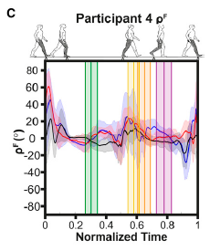
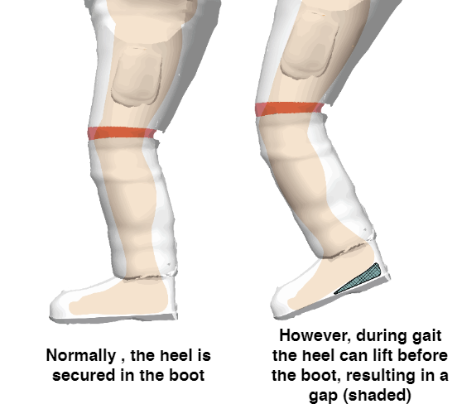
Effect of Fit on Performance
Can an increase in lower torso padding be reflected in objective fit metrics?¹
Results very subject-specific, no clear trend
Fit metrics dynamic over gait cycle
Lower torso fit may need to be focused on foot-boot interface¹
Subjects reported heel-lift, where heel pops out of boot during heel-off
Dynamic differences in human-spacesuit interaction during gait¹
Heel-lift during gait
¹Fineman, R. A., McGrath, T. M., Kelty-Stephen, D. G., Andrew, A. F., & Stirling, L. A. (2018). Objective metrics quantifying fit and performance in spacesuit assemblies. Aerospace Medicine and Human Performance, 89(11), 985–995. https://doi.org/10.3357/AMHP.5123.2018

Slide 15
Gaps
Limited efforts in quantifying fit discrepancies
Limited knowledge on dynamic body shape changes due to motion
No existing framework for incorporating dynamic body-shape models into the spacesuit design and fit process
No studies to quantify the effect of using dynamic body-shape models over linear measurements on fit and mobility

Slide 16
Research Overview

Slide 17
Scope
Limit to spacesuit boot as a test case
Focus on pressurized spacesuit designs
Mechanical counterpressure is an alternative that has not yet been implemented in operational EVA suit design

Slide 18
Hypothesis
Integrating dynamic body shape changes into the spacesuit boot design process will mitigate factors that lead to injury and improve compatibility between the operator and the spacesuit.

Slide 19
Research Aims
Specific Aim 1: Quantify heel-lift in spacesuit gait
Specific Aim 2: Predictively model dynamic changes in foot morphology during gait with statistical shape modeling
Specific Aim 3: Develop a design methodology to integrate shape modeling into planetary spacesuit boot design
Specific Aim 4: Evaluate a prototype planetary spacesuit boot design for fit and comfort

Slide 20
Specific Aim 1
Quantify heel-lift in spacesuit gait

Slide 21
Objectives
Detect heel-off times of both the spacesuit and the operator using the IMUs to detect the presence of heel-lift.
Evaluate use of zero-velocity/zero-position updates to measure heel-lift
Identify the relationship between lower torso fit and heel-lift

Slide 22
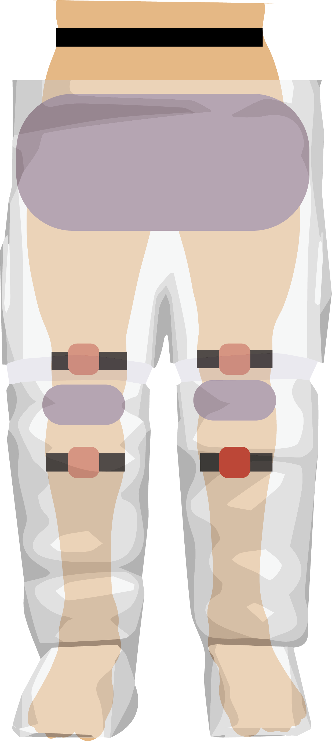
Experimental Data
Collected by Fineman et al. 2018¹
N=3
24 suited trials per config.
No, Low, High Padding
All fit into Large size lower torso
Subjects walked in MK III spacesuit
IMUs collected acceleration and orientation information on both operator’s and spacesuit’s pelvis, thigh, shank
Placement of IMUs (red) and padding (gray) in suit assembly. Additional IMU placed on sacrum

Slide 23
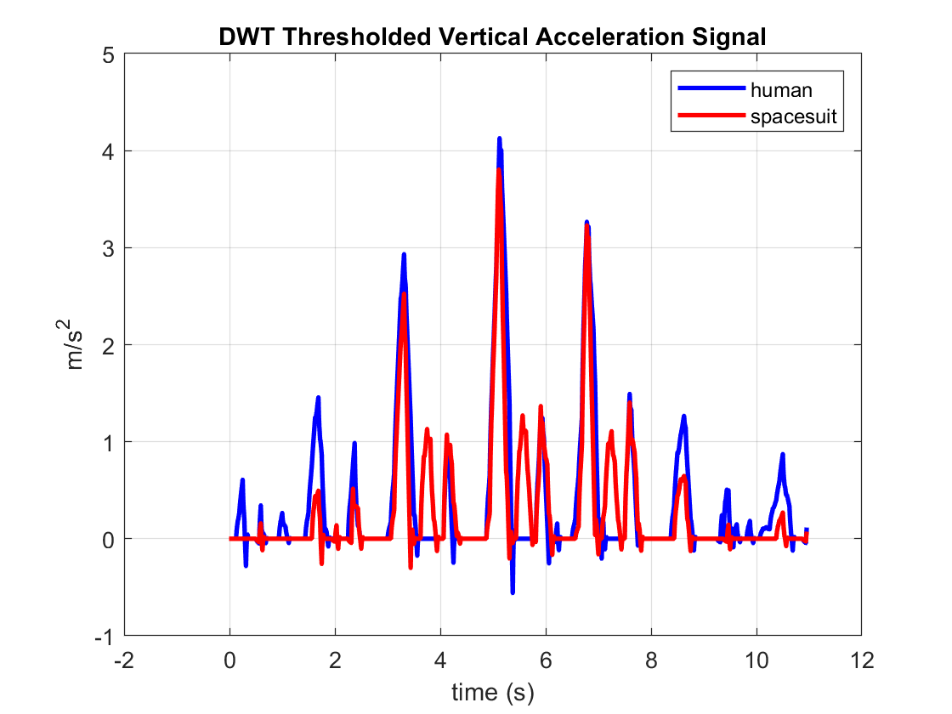
Heel-Off Detection
Discrete Wavelet Thresholding of vertical acceleration signal¹
Stance phase detected as period of zero vertical acceleration per each step
Heel-off detected as end of stance phase
Operator heel-off prior to suit heel-off may indicate heel-lift
DWT transformed signal with “sym2” wavelet
¹Ji, N., Zhou, H., Guo, K., Samuel, O. W., Huang, Z., Xu, L., & Li, G. (2019). Appropriate mother wavelets for continuous gait event detection based on time-frequency analysis for hemiplegic and healthy individuals. Sensors (Switzerland), 19(16), 1–18. https://doi.org/10.3390/s19163462

Slide 24
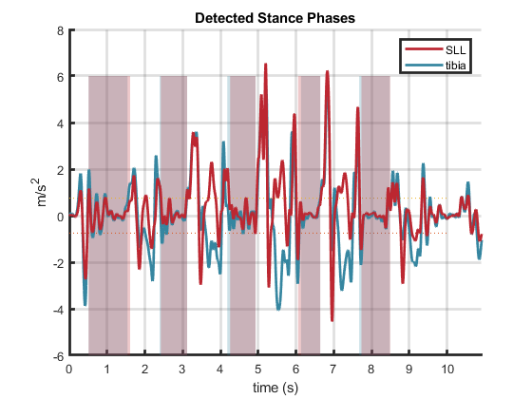
Heel-Off Detection
Discrete Wavelet Thresholding of vertical acceleration signal¹
Stance phase detected as period of zero vertical acceleration per each step
Heel-off detected as end of stance phase
Operator heel-off prior to suit heel-off may indicate heel-lift
Detected stance phases (shaded) during one trial
¹Ji, N., Zhou, H., Guo, K., Samuel, O. W., Huang, Z., Xu, L., & Li, G. (2019). Appropriate mother wavelets for continuous gait event detection based on time-frequency analysis for hemiplegic and healthy individuals. Sensors (Switzerland), 19(16), 1–18. https://doi.org/10.3390/s19163462

Slide 25
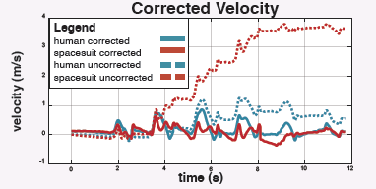
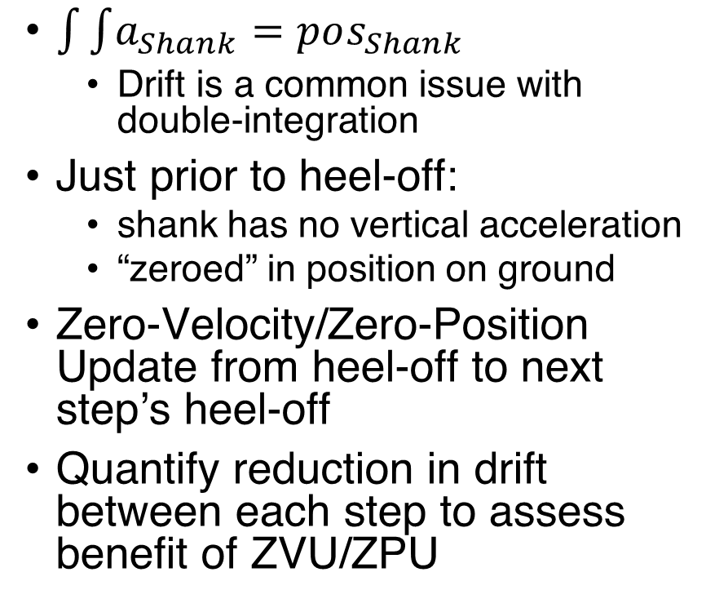
Heel-Lift Measurement
$\int{\int{a_{Shank}}}=pos_{Shank}$
Drift is a common issue with double-integration
Just prior to heel-off:
shank has no vertical acceleration
“zeroed” in position on ground
Zero-Velocity/Zero-Position Update from heel-off to next step’s heel-off
Quantify reduction in drift between each step to assess benefit of ZVU/ZPU
Drift correction from zero-velocity updates
¹Feliz, R., Zalama, E., & García-Bermejo, J. G. (2009). Pedestrian tracking using inertial sensors. Journal of Physical Agents, 3(1), 35–42. https://doi.org/10.14198/jopha.2009.3.1.05

Slide 26
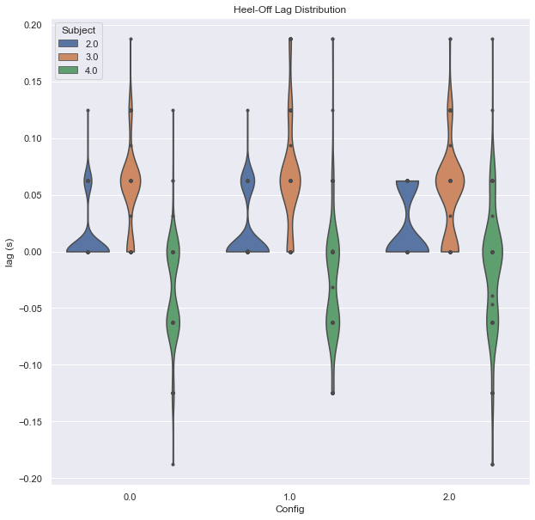
Results
Lag in heel-off time quantified across subjects and conditions
Positive lag may indicate heel-lift
Negative lag may be due to spacesuit’s pressure forces extending lower leg
Negative lag occurred only in subject with largest anthropometry
Drift was not reduced enough to make a quantifiable measurement
At 0.04s, drift may already exceed 1cm in worst case scenario
Distribution of heel-off lags across subjects and configurations (needs larger text size)

Slide 27
Summary
Detect heel-off times of both the spacesuit and the operator using the IMUs to detect the presence of heel-lift.
Evaluate use of zero-velocity/zero-position updates to measure heel-lift
Drift was found to be too excessive to take a measurement even with these methods
Identify the relationship between lower torso fit and heel-lift
Key:
Planned
In Progress
Completed

Slide 28
Specific Aim 2
Predictively model dynamic changes in foot morphology during gait with statistical shape modeling

Slide 29
Objectives
Develop a 4D scanning system to capture foot shape changes during gait cycle
Create a predictive model of foot shape changes across the dorsal surface during stance phase
Identify specific areas of the foot that change shape during stance phase

Slide 30
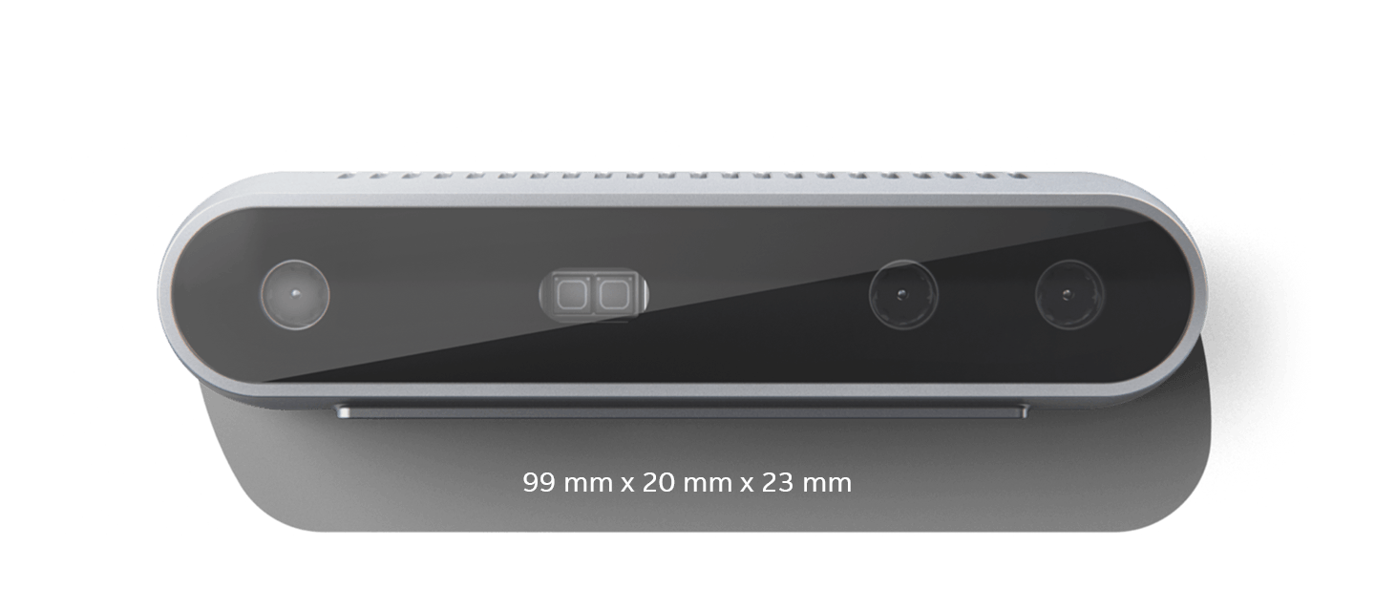
Custom 4D Scanning System
Intel RealSense D415:
$150
90 fps
15cm to 10m range
DynaMo¹: software library to use multiple Intel RealSense cameras for your own applications
Current Features:
Camera Calibration
Data collection from multiple cameras
Marker locations from captured data
Multiple frame iterative camera calibration to expand capture
volume
¹Boppana and Anderson. DynaMo: Dynamic Body Shape and Motion Capture with Intel RealSense Cameras (2019). Journal of Open Source Software.

Slide 31
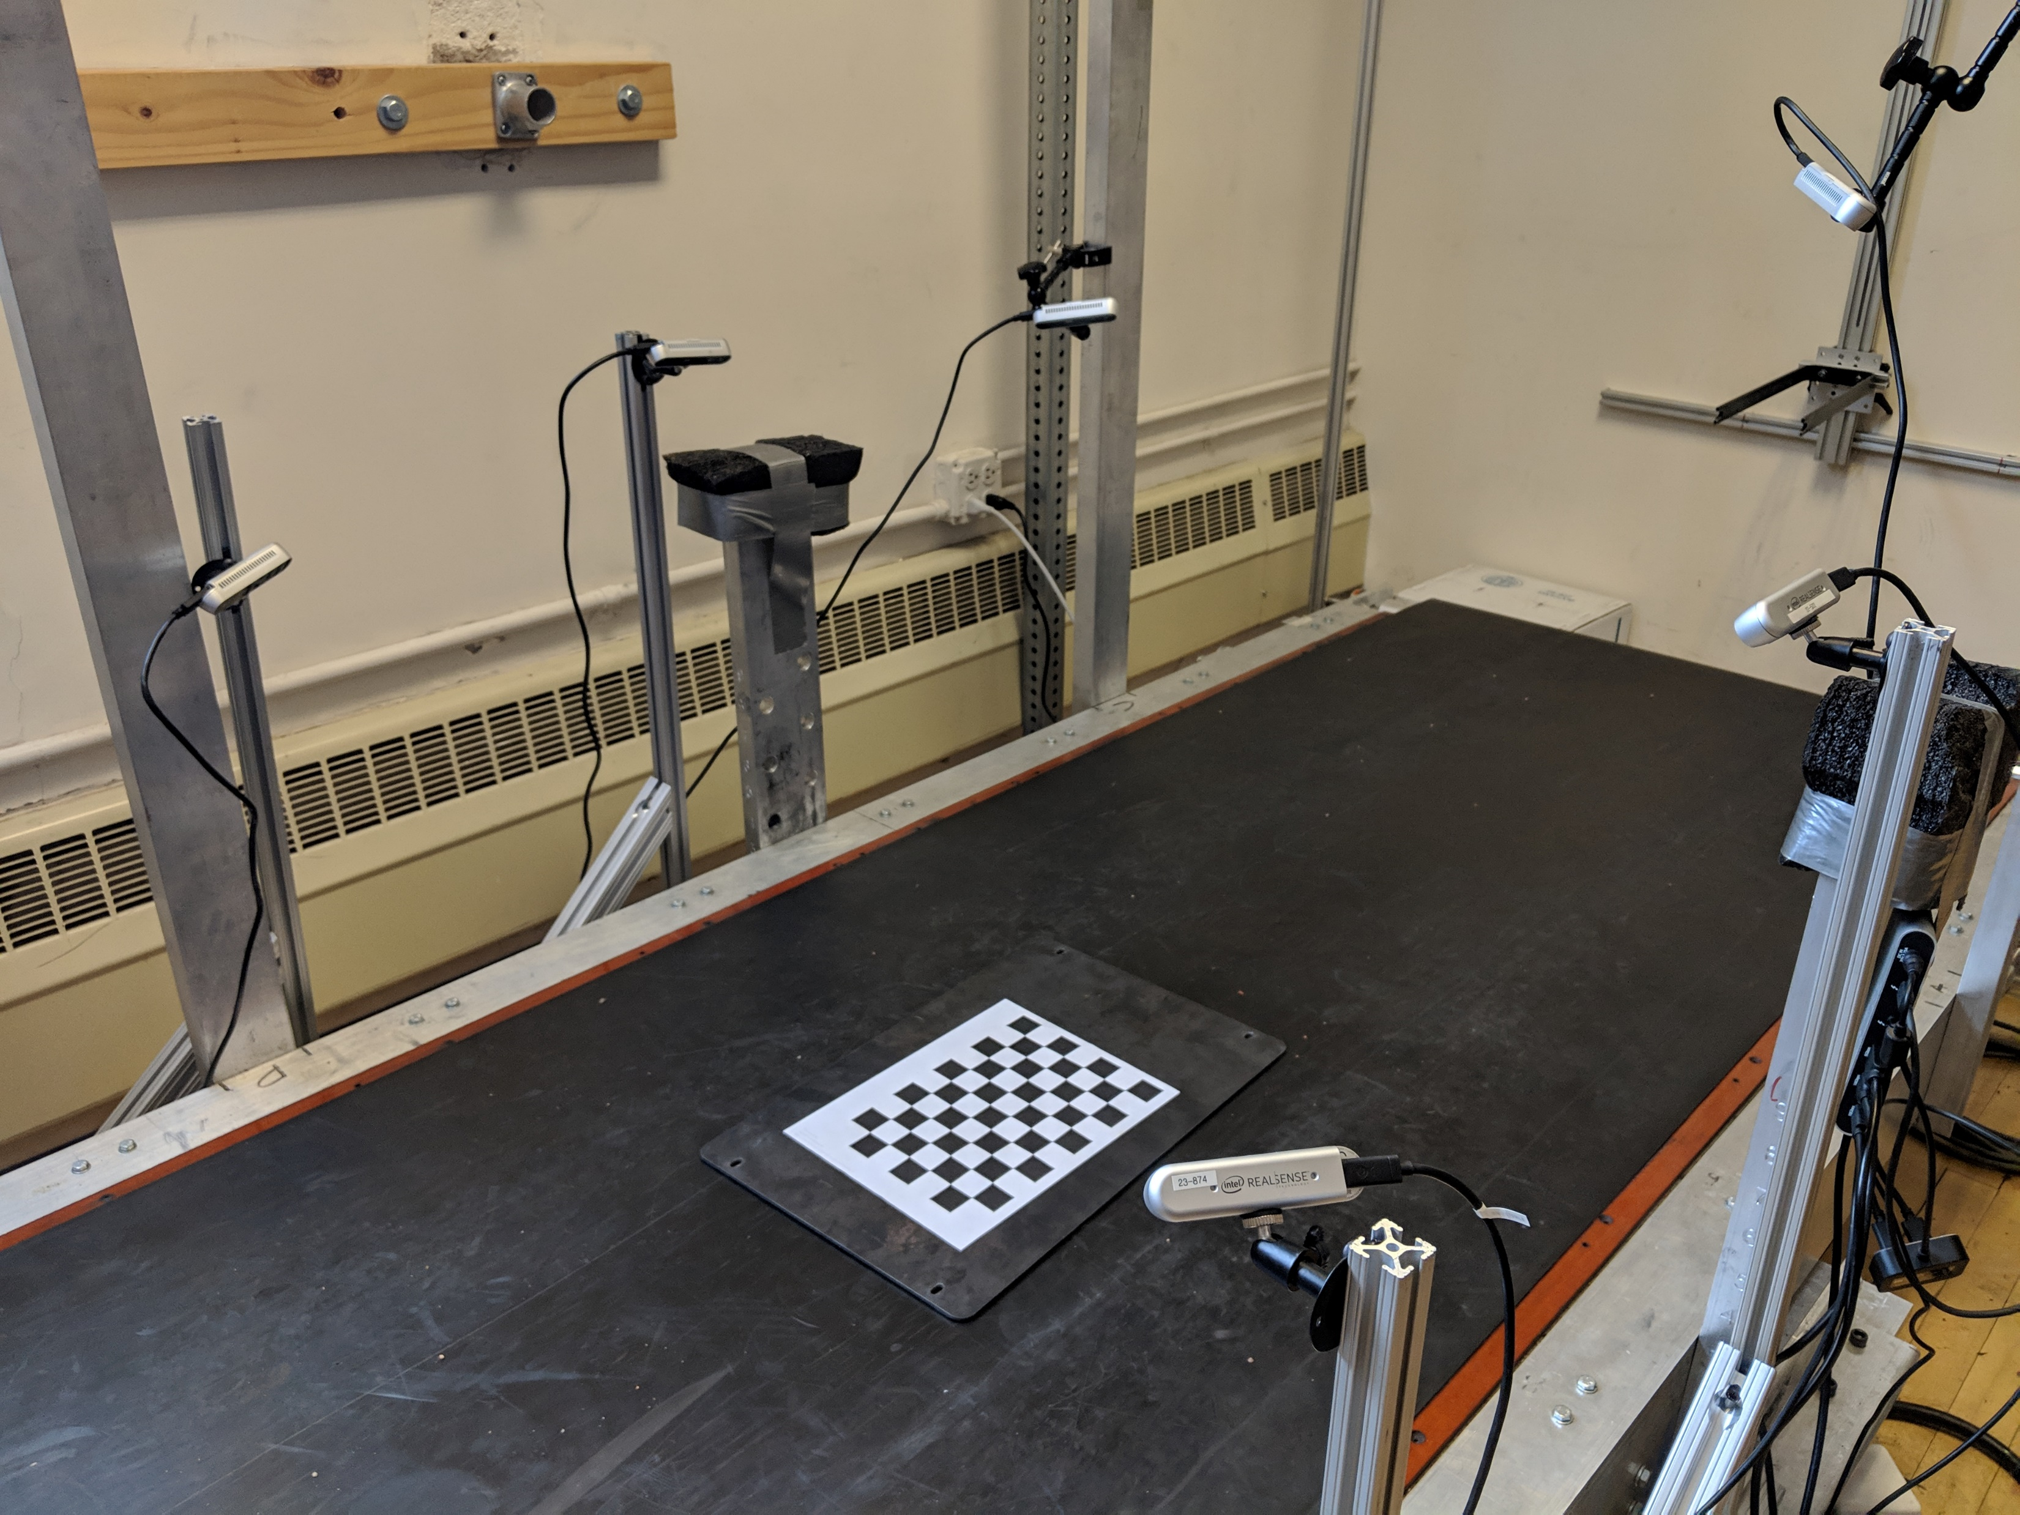
Data Collection Procedures
Subject anthropometry
Height, weight,
Foot length, foot width, arch length with Brannock device
Foot Preparation
Left foot covered in black sock
Right foot marked with 18 reflective markers
Subject walks on treadmill at 1.4 m/s
1 minute warm-up
Data collection for 10 seconds
Review and repeat if necessary
Data collection treadmill in CU Locomotion Laboratory
Notes:
Link to the github

Slide 32
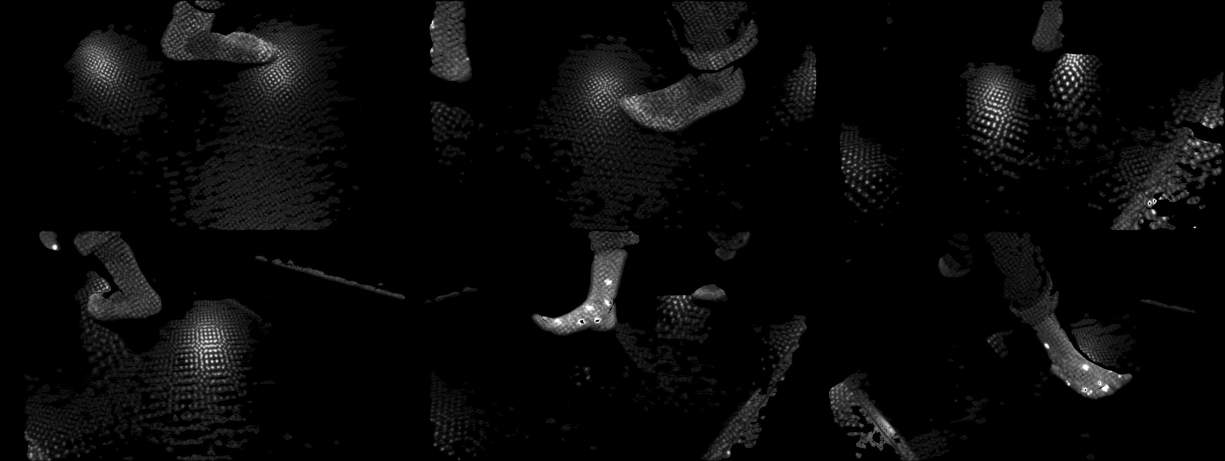
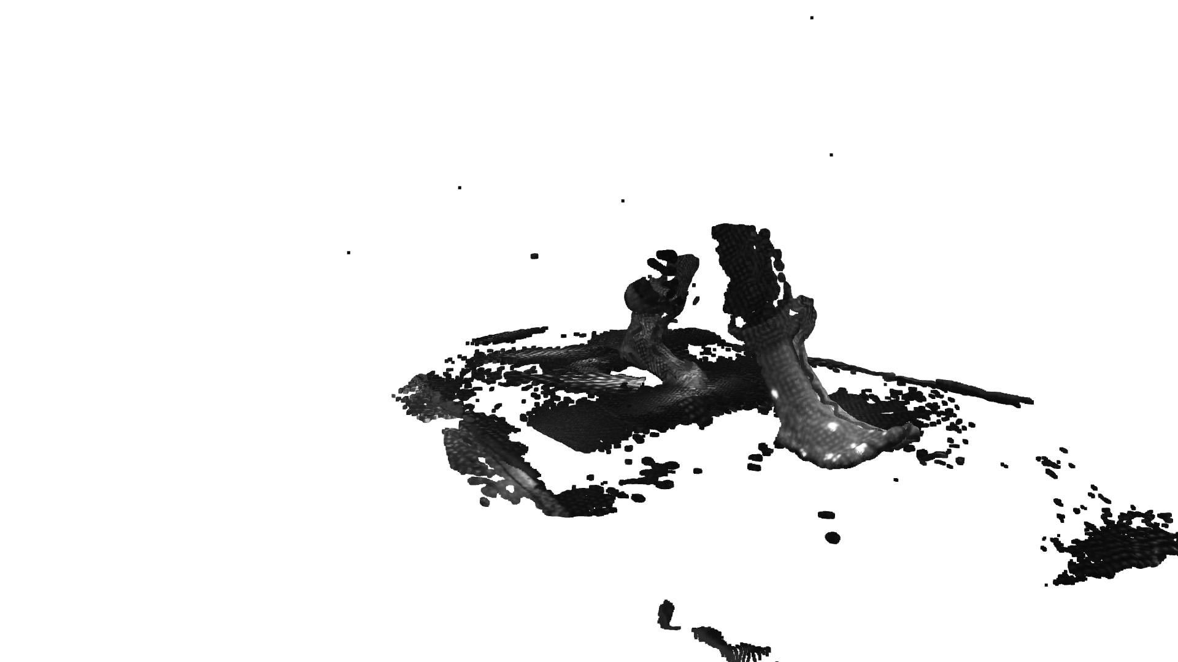
1
2
3
4
5
6
Notes:
Review order of slides

Slide 33
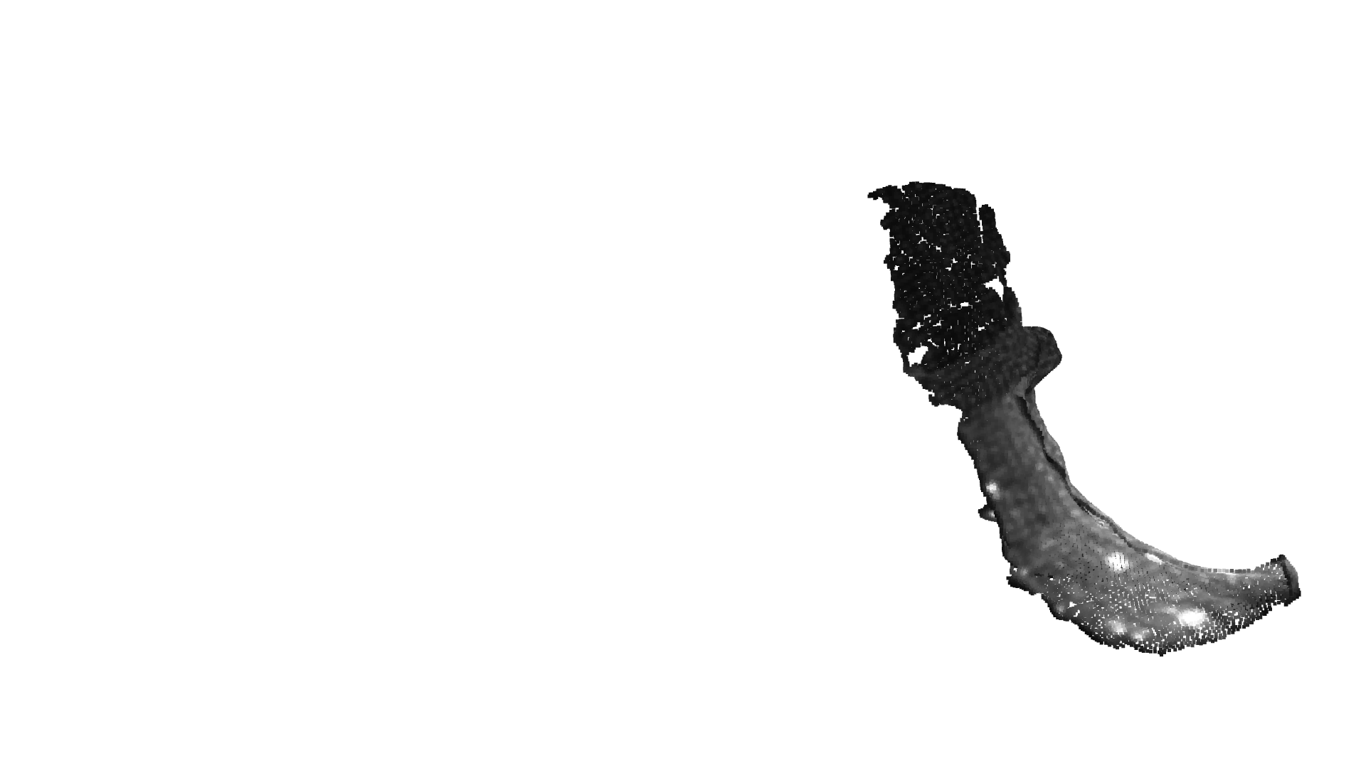
Isolated Foot Capture

Slide 34
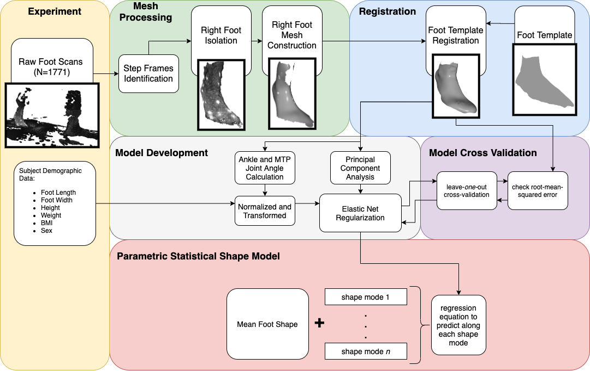
Model Development
Notes:
APSS: algebraic point set surfaces

Slide 35
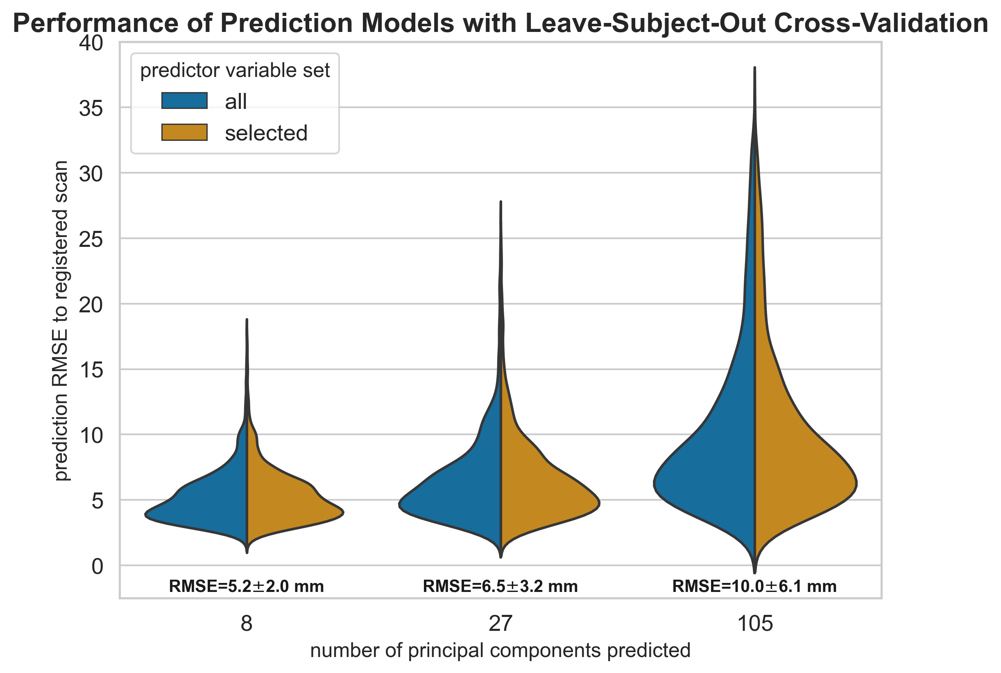
Model Development
Principal components identify axes of highest variation
Elastic Net regularization to calculate linear coefficients for each principal component
Multiple models built to assess how many PCs to predict (8, 27, 105) and inclusion of highly cross-correlated predictors (arch length, BMI, height)
Leave-one-out cross validation with each subject’s scans to assess performance
Model performance across validated models
Notes:
Highly cross-correlated predictors removed
Arch-length
Body mass index
height

Slide 36
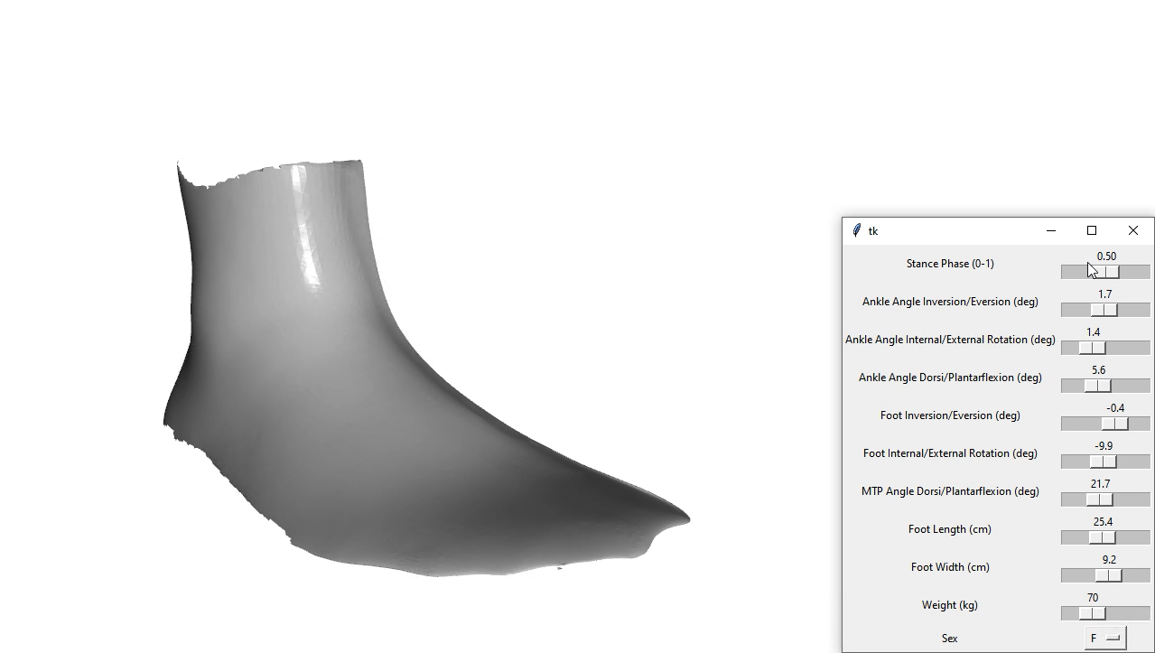
Predictive Foot Shape Model

Slide 37
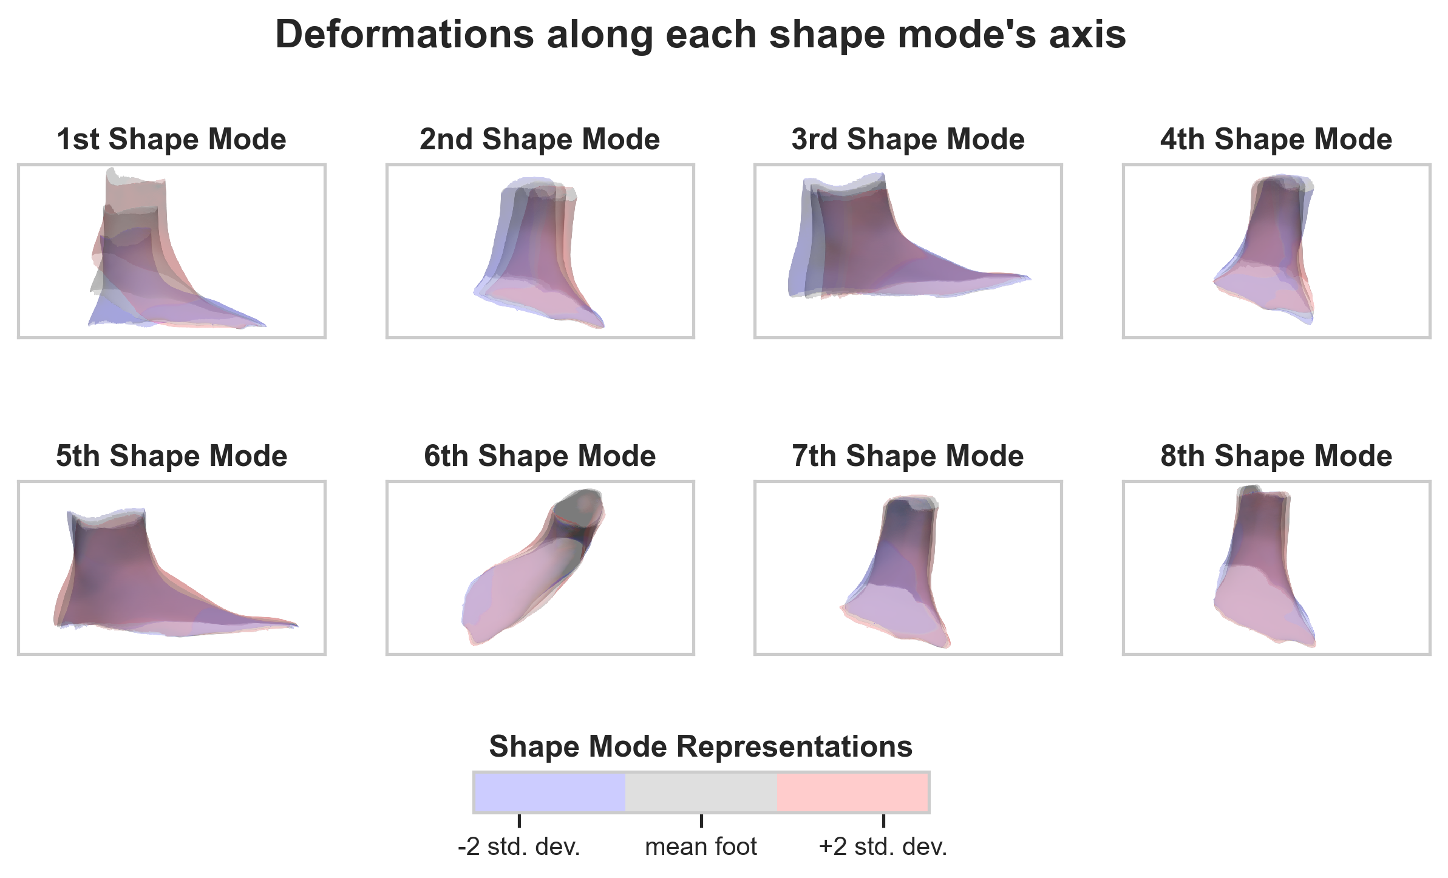
Dynamic Foot Shape Changes
After heel-off (as the MTP joint is dorsiflexing)
Midfoot girth decreased
Just prior to toe-off (ankle eversion and external rotation)
Midfoot, ankle, and MTP joint girth increased
medial malleolus girth decreased
A
B
C
Changes in midfoot girth (A,B), ankle girth (B,C),and malleolus girth (C) during gait

Slide 38
Summary
Develop a 4D scanning system to capture foot shape changes during gait cycle
Create a predictive model of foot shape changes across the dorsal surface during stance phase
Identify specific areas of the foot that change shape during stance phase
Key:
Planned
In Progress
Completed

Slide 39
Specific Aim 3
Develop a design methodology to integrate shape modeling into planetary spacesuit boot design

Slide 40
Objectives
Literature review to characterize foot mobility
Development of a biomechanical framework to integrate foot shape modeling into spacesuit boot design
Design and construction of a spacesuit boot prototype
Fleet sizing analysis of instep height

Slide 41
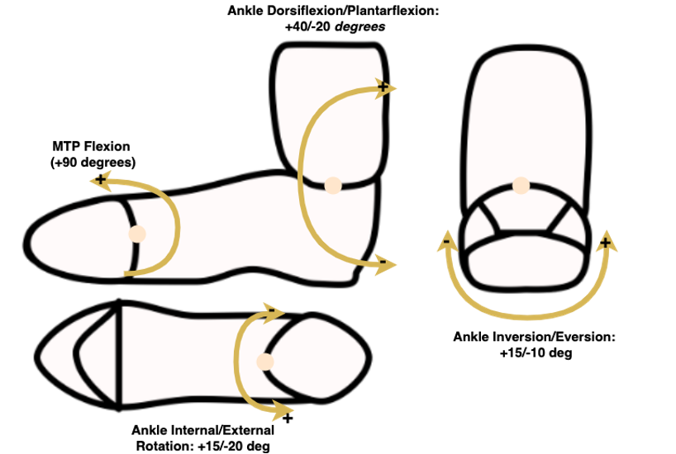
Ideal Foot Mobility

Slide 42
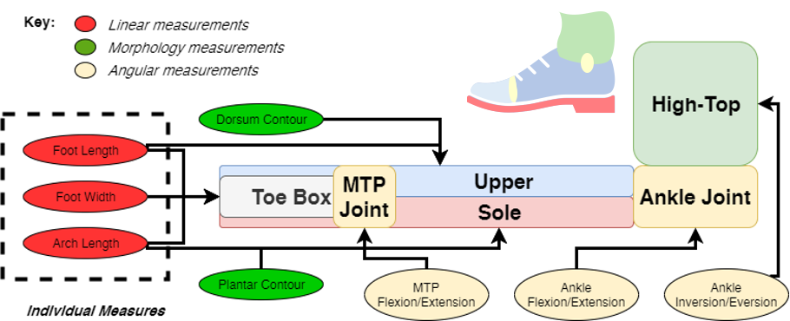
Boot Design Framework

Slide 43
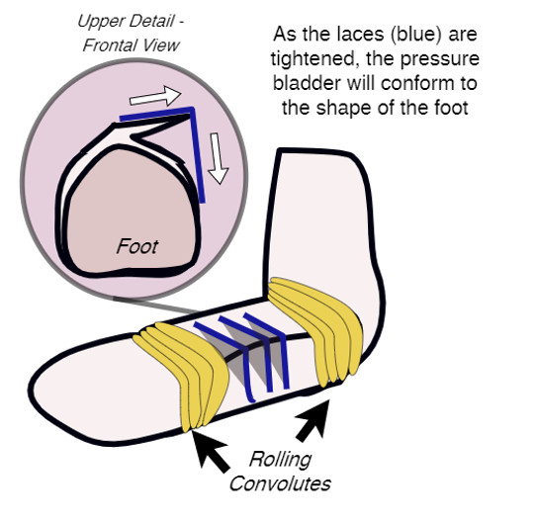
Boot Design
Collaboration with University of Oregon Portland Sports Product Design Department
High-top for ankle stability
Convoluted or bellowed ankle joint
BOA Lacing feature to enable contracting midfoot during heel-off
Limit MTP joint flexibility and use sole to allow for push-off
Example of lacing around midfoot

Slide 44
Boot Design - Interface
Build boot to interface with lab glovebox for pressurized testing
Vacuum pulled in glovebox allows for boot to be pressurized
Test feasibility of pressurized seal around ankle
Test with practice boot
Allows for additional opportunities for testing (SA4)

Slide 45
Fleet Sizing Study
Collaboration with Volumental
Focus on instep height changes in the population
Captured by Volumental across 7 million static foot scans
Incorporate findings from dynamic model (SA2)
Characterize instep height distribution over foot length
Develop sizing recommendations to fit target population

Slide 46
Summary
Literature review to characterize foot mobility
Development of a biomechanical framework to integrate foot shape modeling into spacesuit boot design
Design and construction of a spacesuit boot prototype
Fleet sizing analysis of instep height
Key:
Planned
In Progress
Completed

Slide 47
Specific Aim 4
Evaluate a prototype planetary spacesuit boot design for fit and comfort

Slide 48
Objectives
Evaluate the mobility of the novel design against a standard hiking boot and pressurized hiking boot
Evaluate the comfort of the novel design against a standard hiking boot and pressurized hiking boot

Slide 49
Glovebox Testing
All 3 boots mated to glovebox
Standard hiking boot will be unpressurized
Contact sensor in heel of all boots to check for heel-lift
Unloaded and loaded range-of-motion tests
False floor used for loaded tests
Subjective surveys post-test
Corlett-Bishop Discomfort
Rating of Perceived Exertion
Gravity Compensation and Performance

Slide 50
Stretch Testing Goals
If ankle seal achievable (SA3), can test all three boots in walking conditions
Kinematics
Joint Torques
Full spacesuit testing based on availability

Slide 51
Summary
Evaluate the mobility of the novel design against a standard hiking boot and pressurized hiking boot
Evaluate the comfort of the novel design against a standard hiking boot and pressurized hiking boot
Key:
Planned
In Progress
Completed

Slide 52
Research Summary and Execution Plan

Slide 53
Contributions
Developed method to use IMUs to identify gait landmarks as markers for heel-lift
Gap: Limited efforts in quantifying fit discrepancies
Developed parametric dynamic foot shape model and identified foot shape changes during stance phase
Gap: Limited knowledge on dynamic body shape changes due to motion
Currently designing spacesuit boot with knowledge from foot-shape model and knowledge on foot mobility to serve as framework for future spacesuit component designs
Gap: No existing framework for incorporating dynamic body-shape models into the spacesuit design and fit process
Will quantify mobility and comfort of spacesuit boot design designed using body-shape models against existing designs
Gap: No studies to quantify the effect of using body-shape models over linear measurements on fit and mobility

Slide 54
Publication Plan
TYPE | TITLE | JOURNAL | STATUS | Specific Aim
Technical Note | Detecting Heel-Lift in Spacesuit Gait | Aerospace Medicine and Human Performance | In Preperation | SA1
Journal Paper | DynaMo: Dynamic Body Shape and Motion Capture with Intel RealSense Cameras | Journal of Open Source Software | Published | SA2
Journal Paper | Dynamic foot morphology explained through 4D scanning and shape modeling | Journal of Biomechanics | Under Review | SA2
Conference Paper | A Biomechanical Design Framework to Improve Spacesuit Boot Fit | 50th International Conference on Environmental Systems | Published | SA3
Journal Paper | Static and Dynamic Distribution of Instep Height | Footwear Science | Proposed | SA3
Journal Paper | Design of A Novel Planetary Spacesuit Boot | Acta Astronautica | Proposed | SA3
Journal Paper | Comfort and Mobility Evaluation of a Novel Planetary Spacesuit Boot Design | Aerospace Medicine and Human Performance | Proposed | SA4

Slide 55
Publication Plan
TYPE | TITLE | CONFERENCE | DATE | Specific Aim
Talk | Using dynamic foot morphology data to design spacesuit footwear (Martyn Shorten Award For Innovation) | Footwear Biomechanics Symposium | July 2019 | SA2
Talk | Development of a Dynamic 3D Scanning System with Multiple Intel RealSense Depth Cameras | International Society of Biomechanics Congress | Aug 2019 | SA2
Poster | Quantifying the Heel Lift during Spacesuit Gait | NASA HRP IWS | Jan 2020 | SA1
TBD | Dynamic Body-Shape Models to Reduce Risk Of EVA Spacesuit Injury | NASA HRP IWS | Feb 2021 | Overall
TBD | Novel Spacesuit Boot Design Developed from Dynamic Foot Shape Modeling | Footwear Biomechanics Symposium | July 2021 | SA3
TBD | Spacesuit Boot with Improved Comfort and Mobility Developed from Dynamic Shape Modeling | NASA HRP IWS | Jan 2022 | SA4

Slide 56
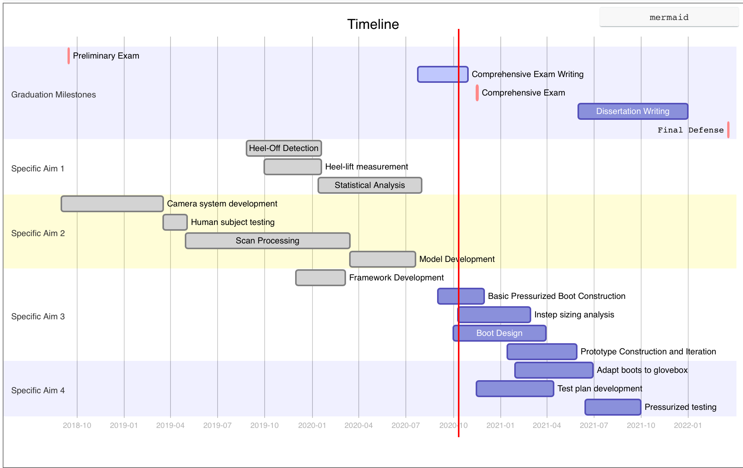

Slide 57
Backup Slides

Slide 58
Spacesuit Contact Injuries
Bruises, contusions
Most common reported injury in EMU
Hands, feet, elbow, knee, trunk
Also reported in Apollo missions at hands
Repeated and high pressure contact between suit and wearer

Slide 59
Spacesuit Musculoskeletal Injuries
Muscle tears, strains, inflammation
Hands and elbows in EMU
High exertion of bending joints
Shoulder in EMU
Excess internal rotation to perform certain reaches
Some cases of surgery

Slide 60
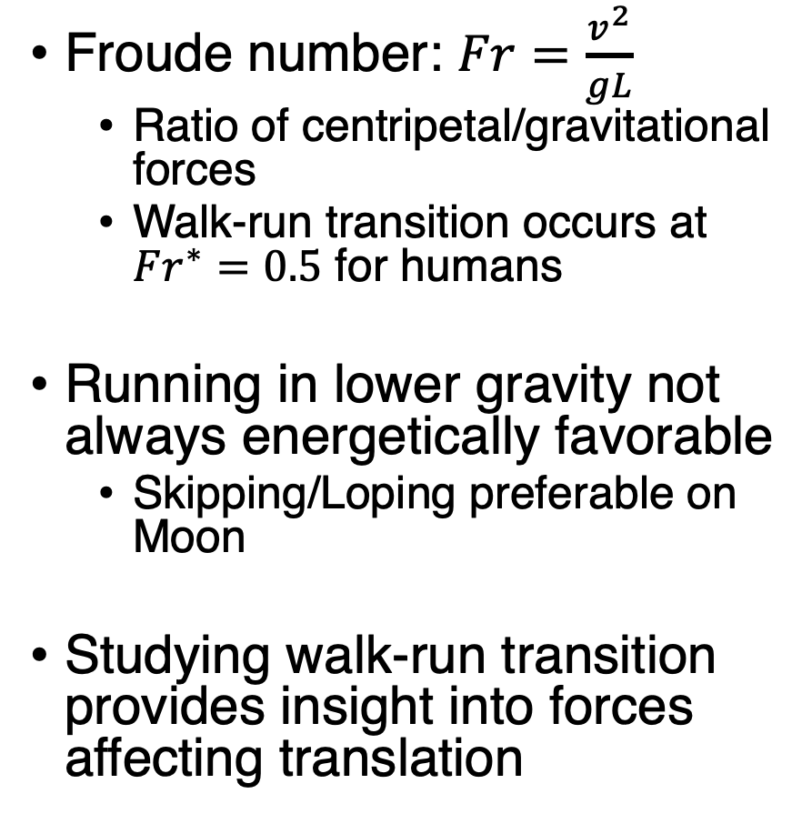
Planetary Ambulation Modeling
Froude number: $Fr=\frac{v^{2}}{gL}$
Ratio of centripetal/gravitational forces
Walk-run transition occurs at $Fr^{∗}=0.5$ for humans
Running in lower gravity not always energetically favorable
Skipping/Loping preferable on Moon
Studying walk-run transition provides insight into forces affecting translation

Slide 61
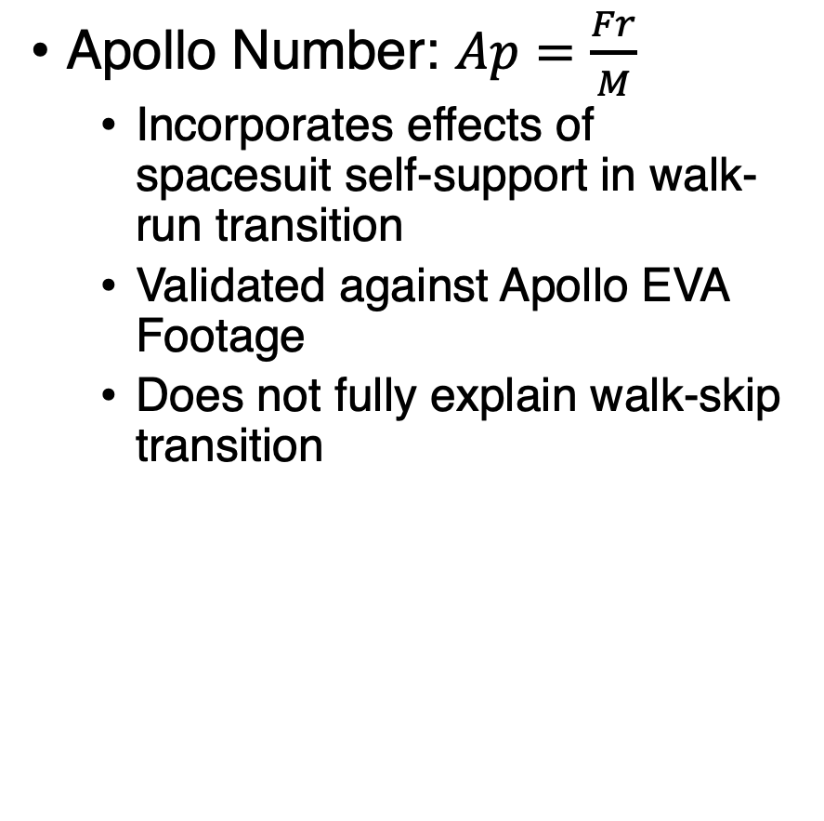
Suited Effects on Ambulation
Apollo Number: $Ap=\frac{Fr}{M}$
Incorporates effects of spacesuit self-support in walk-run transition
Validated against Apollo EVA Footage
Does not fully explain walk-skip transition

Slide 62
Spacesuit Biomechanics Effects
At 4.3 psi, knee joint ROM was limited by suit design¹
Ankle joint ROM increased as a result
Increased exertion of a joint due to suit design can lead to injury (EMU Shoulder injuries)
Inhibited mobility while walking compared to unsuited²
Reduced toe and heel clearance
Decreased speed, stride length, step length
¹Norcross, J., Clowers, K., Clark, T., Harvill, L., Morency, R. M., Stroud, L. C., Vos, J. R., and Gernhardt, M. L., “Metabolic Costs and Biomechanics of Level Ambulation in a Planetary Suit,” NASA/TP-2010-216115, NASA Johnson Space Center, Houston, TX, 2010.
²Cullinane, C. R., Rhodes, R. A., and Stirling, L. A., “Mobility and Agility during Locomotion in the Mark III Space Suit,” Aerospace Medicine and Human Performance, Vol. 88, No. 6, 2017, pp. 589–596.

Slide 63
Quantifying Fit
Difficult to measure in-suit motion
Pressure sensors
IMUs
Objective fit metrics attempt to quantify fit
Task range of motion
Relative coordination metric (is the suit driving the operator or is the operator driving the suit?)

